Slide 1
Toastmasters In Your Community
Transform your skills with Toastmasters
Notes:
Today, I’d like to talk to you about how, with a little help from Toastmasters International, you can transform your public speaking and communications confidence and develop your leadership skills.

Slide 2

What is Toastmasters?
A worldwide nonprofit educational organization that empowers people to become more effective communicators and leaders
A network of over 300,000 members in more than 15,800 clubs across 149 countries
An effective provider of dynamic, high-value, experiential communication and leadership
skills development
Notes:
Let’s start by explaining what Toastmasters is. Toastmasters is a worldwide nonprofit educational organization that empowers people to become more effective communicators and leaders. We are a network of over 300,000 members in more than 15,800 clubs across 149 countries. The organization has been around for nearly 100 years and has built a strong reputation for training individuals in public speaking, communication and leadership. Over the years, the organization has evolved to meet the needs of today’s professionals. Toastmasters International is the most effective provider of dynamic, high-value, experiential communication and leadership skills development in the world.

Slide 3








Members will learn to:
    Develop critical-thinking skills
    Practice time management
    Enhance their listening skills
    Sharpen their presentation skills
    Establish relationships
    Speak without practice
    Take and implement feedback
    Develop leadership skills
Notes:
Every individual has the opportunity for unlimited personal growth. You can use the tools you receive in Toastmasters to broaden your horizons and enhance your skills, such as critical thinking, enhanced listening, and impromptu speaking. The Toastmasters club environment will also help you learn how to take and implement feedback, leading to tremendous professional and personal growth. Along the way, you will receive support from fellow members and will be encouraged to develop positive mentoring relationships within the club.

Slide 4

The Toastmasters club experience
Hands-on learning environment
Practice prepared and impromptu speeches
Receive feedback and evaluations
in a supportive environment
Opportunities to lead at every meeting
Access to a mentor
Meetings held in person, online,
or both
Notes:
Clubs meet as often as you would like them to, with most meeting once a week. The club is a hands-on learning environment that provides members with opportunities to give both prepared and impromptu speeches. After their speeches, they will receive honest, encouraging and structured evaluations from their peers and will have the ability to implement the feedback in a later speech. Each meeting has volunteer leadership roles for members to fill, including the Toastmaster, Evaluator, Ah-Counter and Grammarian. This allows members to serve in a variety of leadership roles and pick up essential skills along the way. Plus, new members will have access to a mentor, who can advise them on an array of topics.

Slide 5

What is the Pathways learning experience?
Pathways is Toastmasters’ education program
Each member receives one free path to start
Choose from 11 paths based on individual goals
Use Pathways online or in print
Work at your own pace
Build professional skills
Notes:
The Pathways learning experience is Toastmasters’ education program. Pathways focuses on five core competencies and 11 specialized learning paths, with more to come. Each member receives one free path to start, and they are able to attempt multiple paths at the same time. When members first log into Base Camp, which is the home of Pathways, they will take an assessment that will recommend three paths for them. Members are free to choose any path they want! All resources and projects are available online or in print. Best of all, they can work at their own pace and learn valuable skills that will translate to their personal and professional lives. The combination of the Pathways learning experience with the supportive environment found in our clubs is what makes Toastmasters such a powerful tool.
*If any of these alternative languages apply to their club, mention their availability. Pathways is available in Arabic, English, French, German, Japanese, Portuguese, Simplified Chinese, Spanish, and Traditional Chinese, with select paths available in Korean and Tamil.*

Slide 6
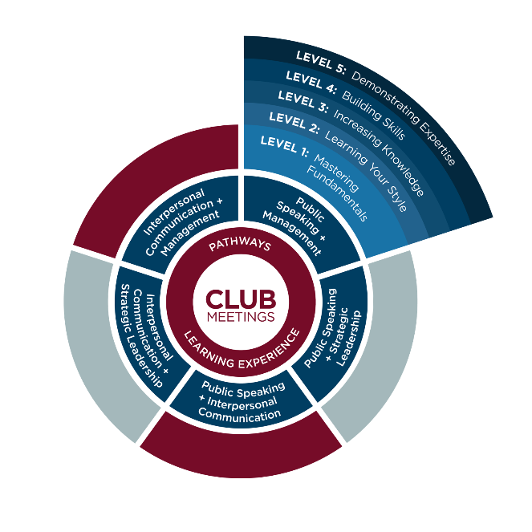
A glimpse into Pathways
Notes:
Here, you can see a little bit about how Pathways works. Everything is centered around the club meetings. Members can go home and spend time in Pathways, choose their path and see what their current assignment is. Within each path, there are five levels. Members will start by Mastering Fundamentals, then Learning Your Style, Increasing Knowledge, Building Skills and finally, Demonstrating Expertise. This method allows members to build skills at their own pace.

Slide 7
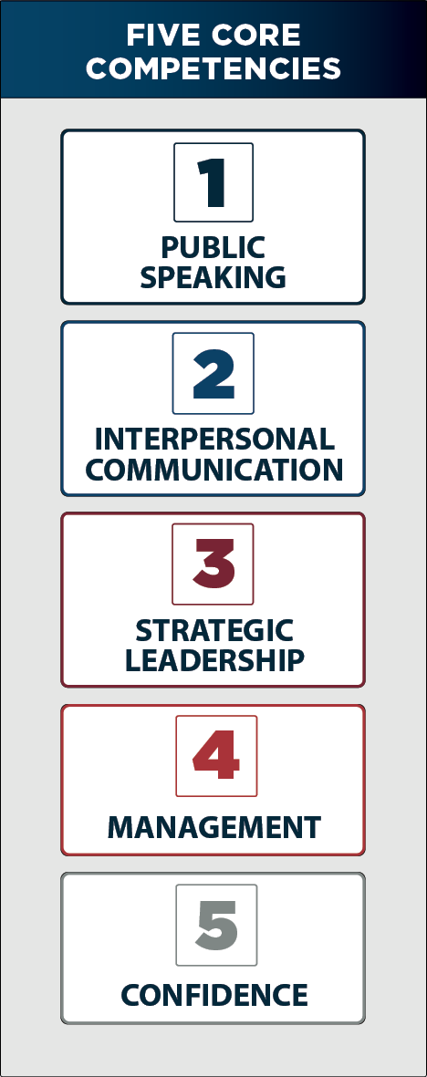
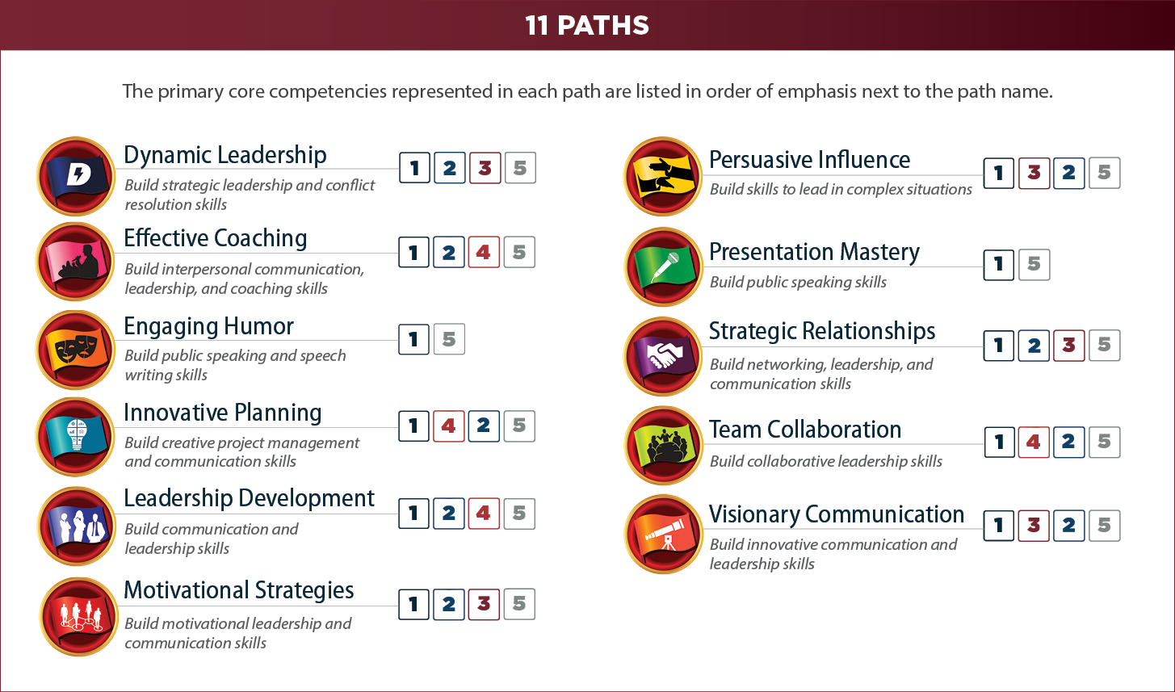
A closer look into Pathways
Notes:
Here’s a glimpse into what Pathways looks like, the current 11 paths and the five core competencies. More paths are being worked on currently. The five core competencies are Public Speaking, Interpersonal Communication, Strategic Leadership, Management and Confidence. Confidence is unique because it cannot be taught, but is gained in every path. In each path, members learn multiple competencies. For example, if they wanted to work on their Public Speaking, Interpersonal Communication and Management, the Leadership Development path is right for them. Or, if they wanted to learn about Persuasive Influence, the core competencies they would learn are Public Speaking, Strategic Leadership, and Interpersonal Communication. In all of these paths, there are over 300 competencies members can learn.

Slide 8
Getting started
Toastmasters is ongoing and affordable
Most cost-effective way to learn
Learning occurs locally, virtually, or both
$125 USD charter fee
$20 USD new-member fee per person
$45 USD six months’ membership dues per person
Notes:
Toastmasters clubs are inexpensive to set up, and unlike other programs, the learning never stops. It offers the most cost-effective way to learn. And you can hold your club meetings at a local location, virtually, or both. It costs $125 USD to charter a new club. A new club requires 20 members to start and there is a $20 USD per person fee for all new members. After that, six months of a Toastmasters membership only costs $45 USD per member.

Slide 9
Toastmasters is here to help
Club mentors assist new clubs for six months
You’ll receive the step-by-step guide How to Build A Toastmasters Club
Each new club receives a charter kit with essential materials
District conferences
Access to Member Services support staff
Visit www.toastmasters.org for more tools and resources
Notes:
You’ll never be at it alone. Each new club is also assigned a club mentor to help out in any way possible for the first six months. They will lead the first few meetings and help ensure your new club gets off to a great start. You’ll receive the step-by-step guide titled How to Build A Toastmasters Club. When you form your new club, you will receive a charter kit, filled with essential materials, including guides and handbooks, marketing material to recruit more members and materials you’ll need to smoothly run your club’s meetings. District conferences are held annually, so your members can meet fellow Toastmasters in your area. There’s also a dedicated Member Services support staff that will always be there to answer your questions. And don’t forget to visit the Toastmasters website for more tools and resources.

Slide 10
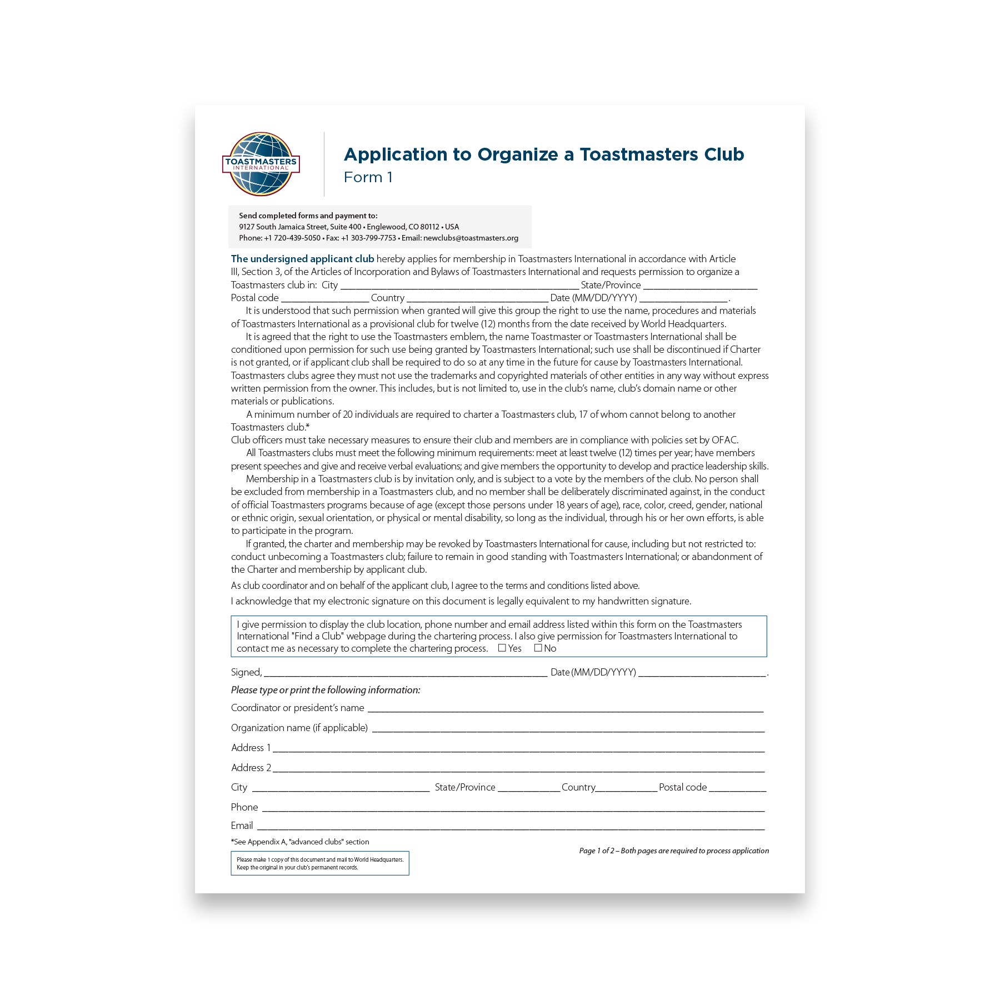
Start your club today!
Identify 20 or more individuals to join your club
Secure a designated place to hold
club meetings
Fill out and submit the Application to Organize and the charter fee
Club Growth Director will guide you through the final steps
For more information or if you have any questions, please call +1 720-439-5050 and ask for the New Clubs team or email newclubs@toastmasters.org
Notes:
Here’s what you need to do to start your club today. First, you need to identify 20 or more individuals to join your club. Next, secure a designated place to hold your club meetings – this can be a company's conference room, library, church, or whatever space you have available. Then, fill out and submit the Application to Organize, along with the charter fee. I will be here to guide you through the final steps. Again, if you have any questions along the way, feel free to call World Headquarters and ask for the New Clubs team or send them an email. Are you ready to get started?

