Slide 1
Find Your Voice
What joining [Insert Club Name Here] can do for you!
Notes:
*Give this presentation a personalized touch by adding in your club’s name above.*
Today, let’s talk about how Toastmasters can help you find your voice.

Slide 2

What is Toastmasters?
A worldwide nonprofit educational organization that empowers people to become more effective communicators and leaders
A network of over 270,000 members in more than 14,000 clubs across
150 countries
An effective provider of dynamic, high-value, experiential communication and leadership skills development
Notes:
Some of you may have heard of Toastmasters before, and some may not have. Toastmasters is a worldwide nonprofit educational organization that empowers people to become more effective communicators and leaders. We are a network of over 270,000 members in more than 14,000 clubs in 150 countries. Toastmasters International an effective provider of dynamic, high-value, experiential communication and leadership skills.

Slide 3








Members will learn to:
    Develop critical-thinking skills
    Practice time management
    Enhance their listening skills
    Sharpen their presentation skills
    Establish relationships
    Speak without practice
    Take and implement feedback
    Develop leadership skills
Notes:
Every individual has the opportunity for unlimited personal growth. You can use the tools you receive in Toastmasters to broaden your horizons and enhance your skills, such as critical thinking, enhanced listening, and impromptu speaking. The Toastmasters club environment will also help you learn how to take and implement feedback, leading to tremendous professional and personal growth. Along the way, you will receive support from fellow members and will be encouraged to develop positive mentoring relationships within the club.

Slide 4

The Toastmasters club experience
Hands-on learning environment
Practice prepared and impromptu speeches
Receive feedback and evaluations
in a supportive environment
Opportunities to lead at every meeting
Access to a mentor
Meetings held in person, online,
or both
Notes:
Our club meets *insert how often your club meets*. The club is a self-paced, hands-on learning environment that provides you with opportunities to give both prepared and impromptu speeches. After you give your speech, you will receive honest, encouraging, and structured evaluations and will have the ability to implement the feedback in a later speech. Each meeting has volunteer leadership roles, including the Toastmaster, Evaluator, Ah-Counter, and Grammarian. Plus, you will have access to a mentor, who can help and offer advice.

Slide 5

What is the Pathways learning experience?
Pathways is Toastmasters’ education program
Each member receives one free path to start
Choose from 6 paths based on your goals
Use Pathways online
Work at your own pace
Build professional skills
Notes:
The Pathways learning experience is Toastmasters’ education program. Pathways focuses on five core competencies and six specialized learning paths. Each member receives one free path to start, and they are able to work on multiple paths at the same time. When you are ready to select your path, you can take an assessment that will recommend three paths for you. You are free to choose any path you want! You'll access your projects and resources online, on Base Camp, the home of Pathways. Some resources can be downloaded and printed to support your learning. Best of all, you can work at your own pace and along the way, you will build skills to help you in your personal or professional life. The combination of the Pathways learning experience with the supportive environment found in our club is what makes Toastmasters such a powerful tool.
*Pathways is available in Arabic, English, French, German, Japanese, Korean, Portuguese, Simplified Chinese, Spanish, Tamil, and Traditional Chinese. If any of these alternative languages apply to your club, mention their availability*

Slide 6
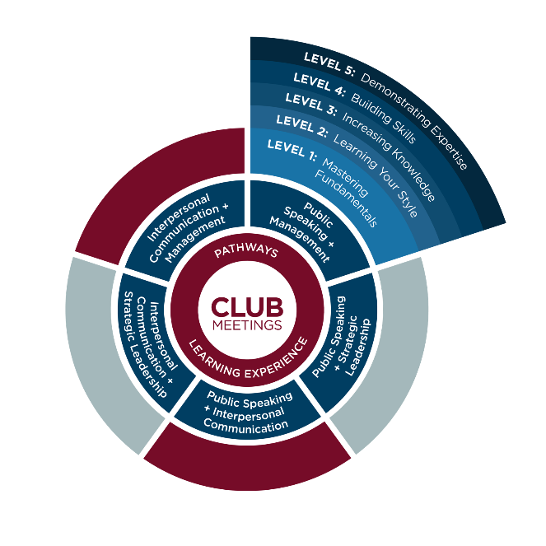
A glimpse into Pathways
Notes:
Here, you can see a little bit about how Pathways works. Everything is centered around the club meetings. Members can go home and spend time in Pathways, choose their path, and see what their current assignment is. Within each path, there are five levels. Members will start by Mastering Fundamentals, then Learning Your Style, Increasing Knowledge, Building Skills, and finally, Demonstrating Expertise. This method allows members to build skills at their own pace.

Slide 7
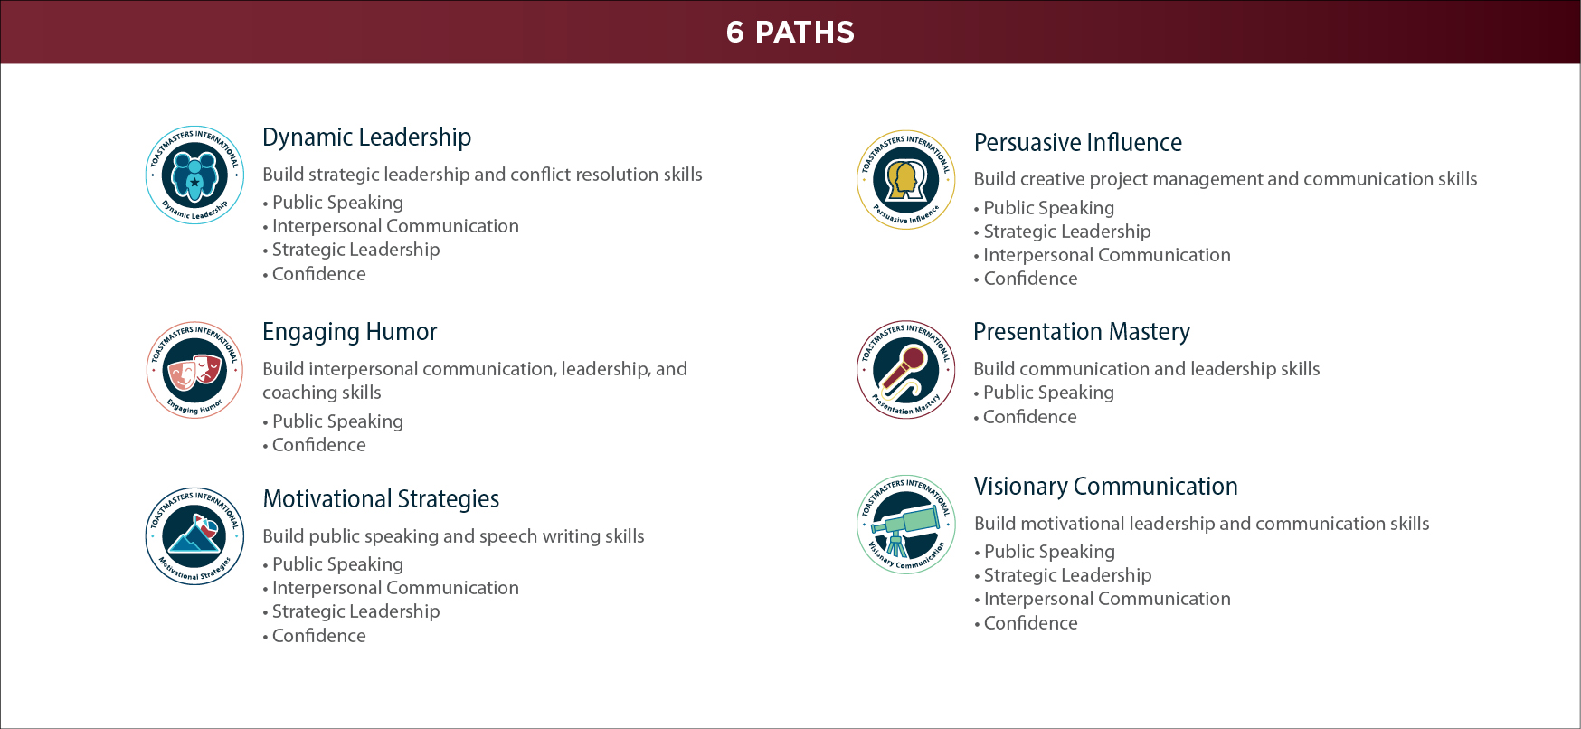
A closer look into Pathways
Notes:
Pathways includes over 300 competencies that members can learn across all paths. Here, we see some of the core competencies included in each path. Every path includes the opportunity to build confidence, which is one of Toastmasters core competencies. It's unique because it can be taught, but is a skill all members have the opportunity to build. In each path, you learn multiple competencies. For example, if you wanted to work on your Public Speaking, Interpersonal Communication, and Strategic Leadership, the Dynamic Leadership path is right for you. Or, if you wanted to learn about Persuasive Influence, the core competencies you would learn are Public Speaking, Strategic Leadership, and Interpersonal Communication. In all of these paths, there are over 300 competencies you can learn.

Slide 8

How the evaluation process works
Notes:
Here’s a preview of what the evaluation form looks like. You are evaluated on skills such as vocal variety, eye contact, gestures, and comfort level. Each skill has clearly outlined criteria that correspond to a number score, ranging from one to five. It is important to note that a score of three means that you met the criteria, did what you were supposed to do, and did it well. There’s also room for the evaluator to write any comments they have. These evaluations are a great tool to learn what areas you need to improve on and which you excel at, as well as allowing you to actually track your progress and growth.

Slide 9
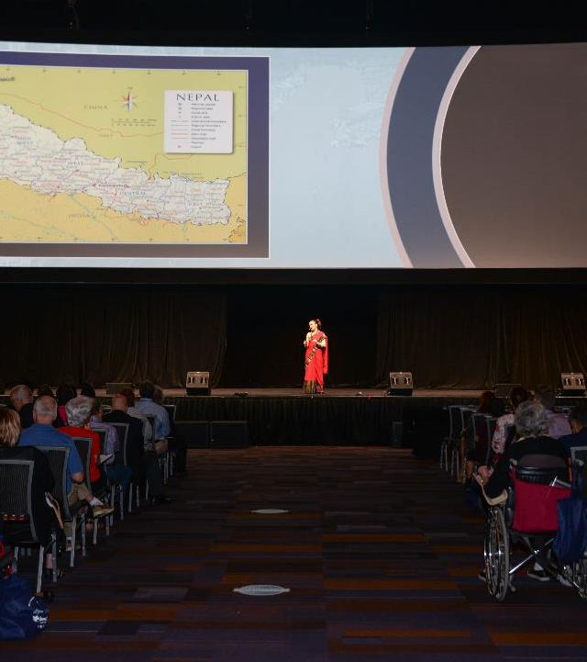
Learning doesn’t stop at the club
Subscription to the Toastmaster magazine
Speech contests
International Convention
District conferences
Access to helpful resources at toastmasters.org
Notes:
The learning doesn’t stop at the club. Active members receive a Toastmaster magazine subscription filled with guidance on public speaking, leadership, featured articles on fellow Toastmasters, and much more. Toastmasters offers the opportunity to compete in speech contests culminating in finalists competing in the World Championship of Public Speaking®. This contest is held at the Toastmasters International Convention, which also features education sessions and a chance to cast your club’s vote on important business matters at the Annual Business Meeting. We also provide District conferences, where you can meet fellow Toastmasters in the area and connect with them. You can find more helpful resources by visiting the Toastmasters website.

Slide 10
Break barriers, not your budget
Compared to conferences and seminars, Toastmasters is ongoing and affordable
Most cost-effective way to learn
$20 USD new-member fee
per person
$60 USD six months’ membership dues per person
[Insert any additional club dues]
Other education training programs average $1,995 USD per person
Notes:
Clubs are inexpensive to join, and unlike other programs, the learning never stops. Toastmasters offers the most cost-effective way to learn and no other company offers what we offer in the same model. There is a one-time $20 USD fee for new members and then after that, membership costs are only $60 USD for six months. Our club also has an additional charge of *insert charge here*. Toastmasters allows you to break down barriers, while not breaking your budget. Meanwhile, other companies offer seminars with limited learning potential and cost nearly $2,000 USD.

Slide 11
A preview of the club experience
[Presenter name]
[Speech topic or title]
[How long in Toastmasters?]
[Any leadership roles held?]
[Recognition status]
Notes:
*Note: use this slide to welcome your club member who will be presenting a speech at the meeting. Give time afterwards to have an evaluator evaluate their speech so prospective members can feel what the club experience is truly like. You may also take some time to partake in Table Topics. Make sure you call on some of your guests to speak!*

Slide 12

Ready to join?
Here’s how!
Speak with the Vice President Membership, [Name of VP]
Complete the Application for Membership
Return the completed application
with your dues to the Vice President Membership
Notes:
*Add your club’s VP Membership’s name. Feel free to add their contact information as well so guests can reach out to them with any questions or comments they have. *
Are you ready to join our club? Start by speaking with our Vice President Membership and completing the application. When you’re done, return the completed application with your dues and you’re ready to enjoy the numerous benefits of being a Toastmaster!

