Slide 1

Notes:
[BOTH AUDIENCES]
Hello and welcome!
The purpose of this presentation is to provide an overview of the alliance between Rotary and Toastmasters and to share how you and your club can participate.

Slide 2




The Alliance
Learn More
Get Involved
Notes:
[ROTARY AUDIENCE]
In this session, we'll cover the goals of the alliance, learn more about Toastmasters, and share ways you can get involved.
[TOASTMASTERS AUDIENCE]
In this session, we'll cover the goals of the alliance, learn more about Rotary, and share ways you can get involved.

Slide 3

The Alliance
Notes:
[BOTH AUDIENCES]
Let’s start by talking about the alliance.

Slide 4
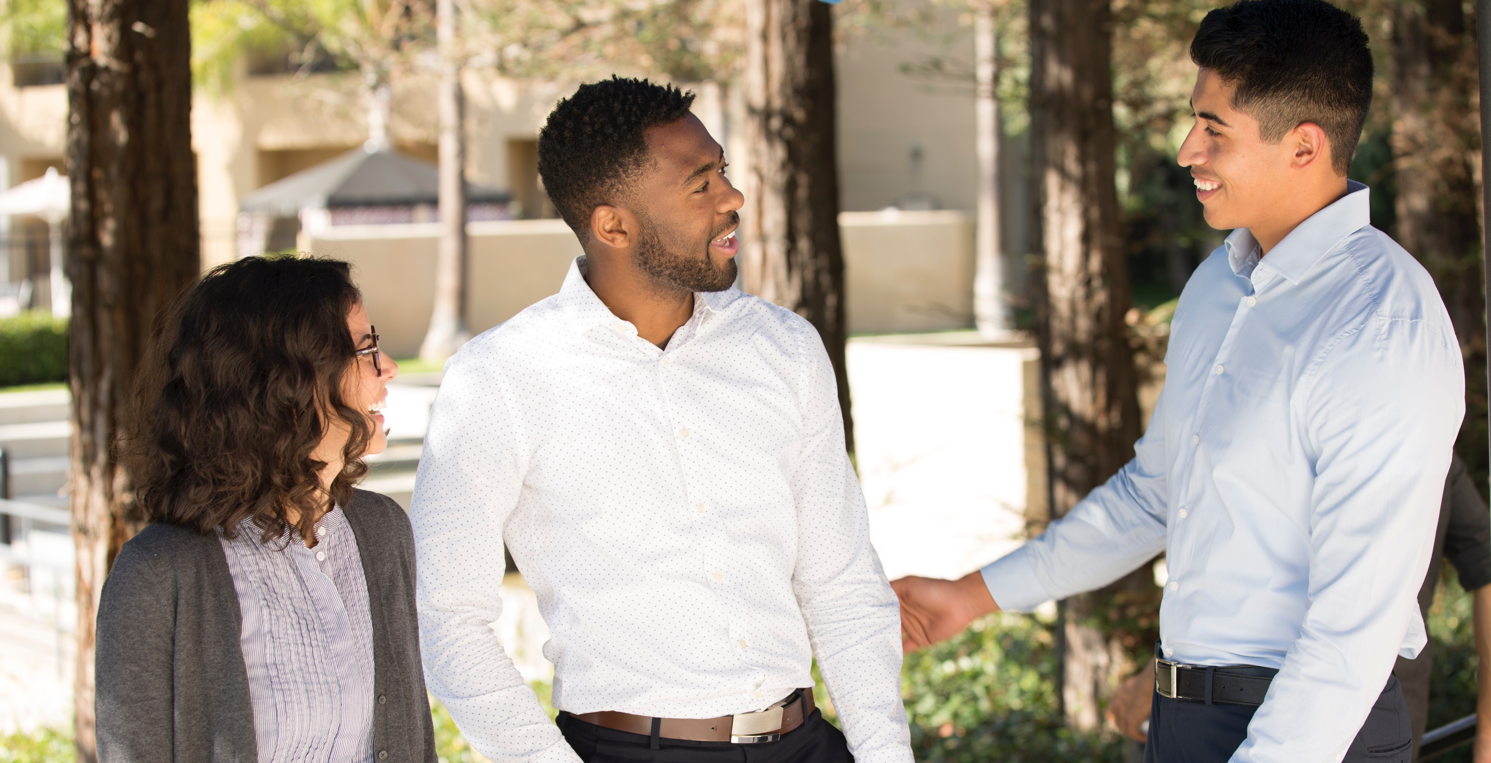
Personal and professional
growth opportunities
Notes:
[BOTH AUDIENCES]
Our organizations are working together to enhance the member experience by providing each of our members with more opportunities for personal and professional growth.
Being able to express yourself confidently in front of an audience is a learned skill that has immense benefits, personally and professionally, in the office, at the club, and even at home. Sharing our stories can inspire others and build community. By expanding our personal and professional skills, we are creating lasting change within ourselves, and by doing so, we are better able to serve our clubs and our communities.

Slide 5

Benefits
ROTARY
TOASTMASTERS
New leadership development curriculum
Increase collective impact
Connect with more people
Opportunities for
Service
Speaking
Learning
Membership
Connections
Take advantage of new speaking and learning opportunities
Enhance fellowship and connections
Build stronger clubs
Make a difference
in your community
Notes:
[BOTH AUDIENCES]​
Our alliance offers benefits to members of both organizations. ​
Members of Toastmasters are be able to connect with more people, take advantage of new speaking and learning opportunities, and use their skills to make a difference in their communities with Rotary. For example, we recently heard about a Toastmasters member who developed a relationship with his local Rotary club, which led to him leading a public speaking workshop for Rotarians. He was excited to use his expertise to help others while practicing his communications skills with a new and bigger audience. ​
Members of Rotary have a new leadership development curriculum to develop and improve their leadership and communication skills, opportunities to enhance their fellowship and connections, build stronger clubs, and increase their collective impact by collaborating with their Toastmasters clubs. ​
Both organizations benefit from increased service, speaking, learning, and membership opportunities, as well as increased connections.​

Slide 6

Learn More About Rotary
Notes:
[ROTARY AUDIENCE]
Now, let’s learn more about Toastmasters.
[TOASTMASTERS AUDIENCE]
Now, let’s learn more about Rotary.

Slide 7
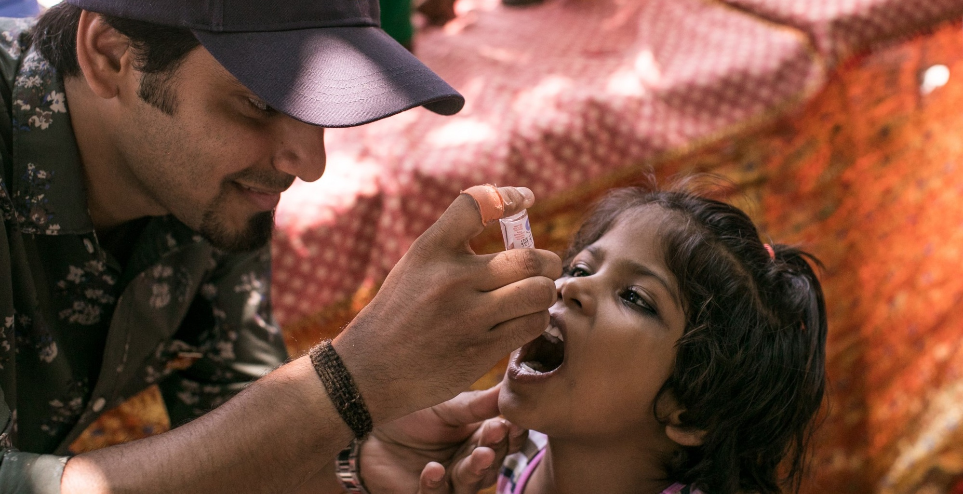
What is Rotary?
Notes:
[TOASTMASTERS AUDIENCE]
Like Toastmasters, Rotary is also an international organization of clubs. Rotary members join together to solve problems in their communities and make a difference in the lives of others. Their #1 priority is eradicating polio worldwide. Rotary has been working to eradicate polio since 1988. Since then, Rotary and its partners have reduced polio cases by more than 99.9% worldwide.

Slide 8
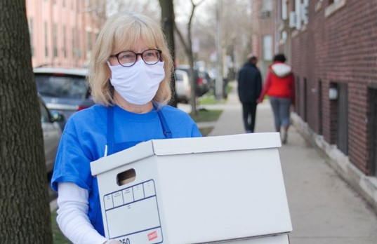
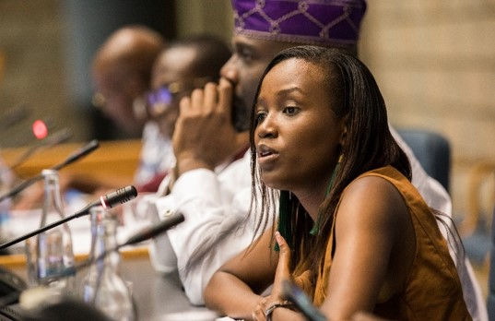
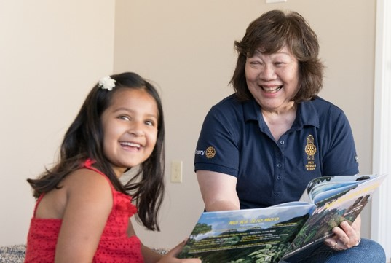
Rotary’s causes
Peacebuilding and conflict prevention
Disease prevention and treatment
Water, sanitation, and hygiene
Maternal and child health
Basic education and literacy
Community economic development
Notes:
[TOASTMASTERS AUDIENCE]
Rotary members believe they have a shared responsibility to take action on our world’s most persistent issues. Their 36,000+ clubs work together to:
Promote peace
Fight disease
Provide clean water, sanitation, and hygiene
Save mothers and children
Support education
Grow local economies
Members can apply for global grants for projects that fall into one of these areas of focus. Their mission is “We provide service to others, promote integrity, and advance world understanding, goodwill, and peace through our fellowship of business, professional, and community leaders.”

Slide 9
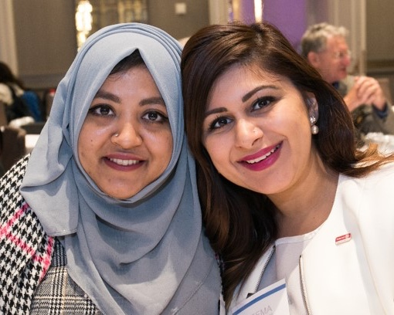
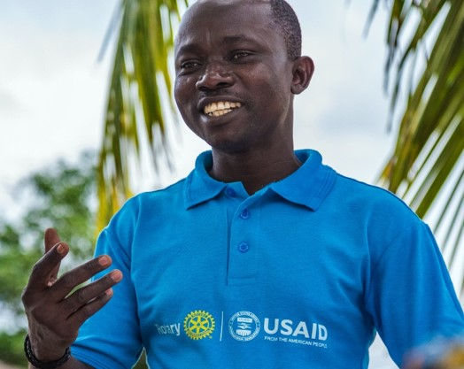
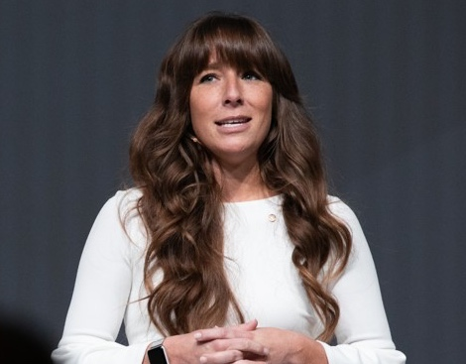
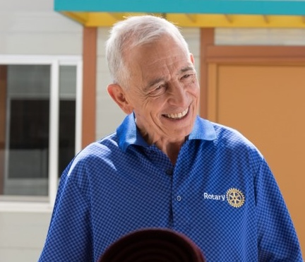
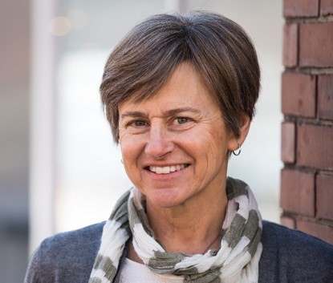
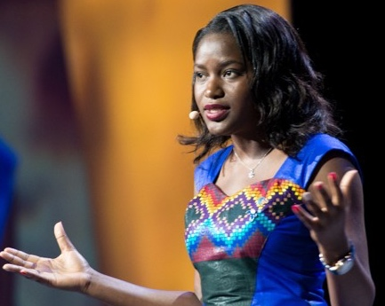
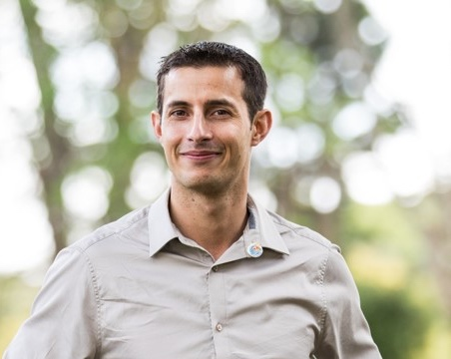
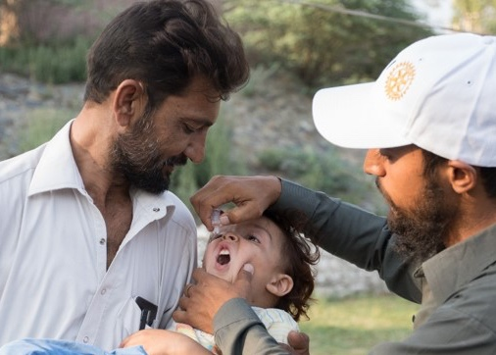
Rotary Members
Notes:
[TOASTMASTERS AUDIENCE]
Rotary's 1.2 million members are --- neighbors, friends, leaders, and problem-solvers who see a world where people unite and take action to create last change – across the globe, in their communities, and in themselves.
Rotary members are called Rotarians. The criteria for being a Rotarian are simple: Be an adult who demonstrates good character, integrity, and leadership; have a good reputation within your profession and community; and be willing to serve in the community or around the world.

Slide 10
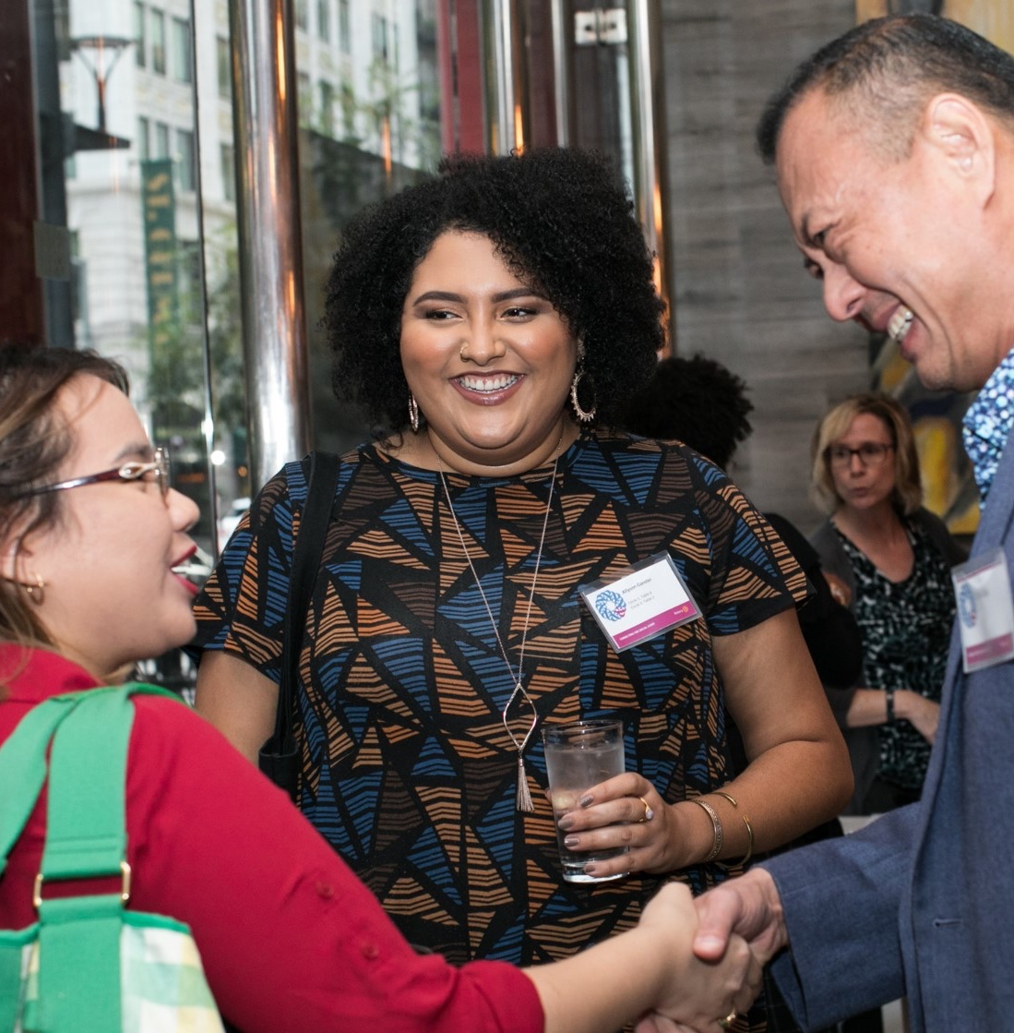
Clubs
Rotary Clubs
Rotaract Clubs
Interact Clubs
Notes:
[TOASTMASTERS AUDIENCE]
Rotary clubs are where members come together to strengthen their connection with friends and neighbors and their commitment to improving lives. They are all grounded in the same values, but each one is unique, because each community has its own unique needs.
Rotary's clubs for young leaders are called Rotaract clubs, and their members are Rotaractors. Rotaract clubs meet to exchange ideas with leaders in the community, develop leadership and professional skills, and have fun through service. Historically for young leaders ages 18-30, Rotaract is now open to members of any age and no longer need a Rotary club to sponsor them.
Interact clubs connect people ages 12-18 with others in their community or school to learn about the world through service projects and activities. They are sponsored by their local Rotary clubs.
Many clubs are adapting to online meetings as needed.

Slide 11
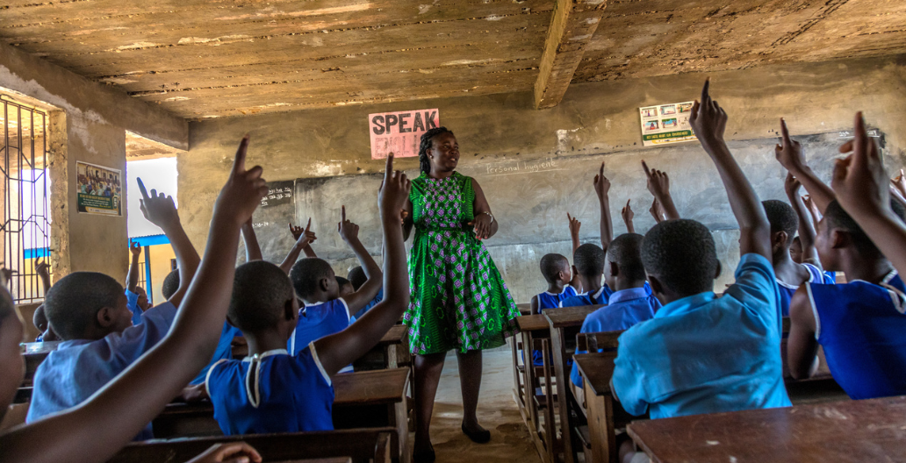
The Rotary Foundation
Notes:
[TOASTMASTERS AUDIENCE]
The Rotary Foundation helps fund humanitarian activities, from local service projects to global initiatives. Since it was founded more than 100 years ago, it has funded more than $4 billion in life-changing, sustaining projects.
The mission of The Rotary Foundation of Rotary International is to enable Rotarians to advance world understanding, goodwill, and peace through the improvement of health, the support of education, and the alleviation of poverty.
Pictured here is a teacher instructing her classroom on personal hygiene practices at a school in Ghana. Rotarians from 35 clubs across the country are partnering with USAID and national and local agencies of the government of Ghana in a large-scale $4 million program in water, sanitation and hygiene project serving 75,000 people.

Slide 12


Organization structure
Club Leaders
Assistant Governor
District committees
District Governor
Regional Leaders
Board of Directors and
Board of Trustees
Club Leaders
Area Director
Division Director
District Director
Region Advisors
Board of Directors
Notes:
[TOASTMASTERS AUDIENCE]
As you can see our organizations are structured very similarly, from club leaders all the way up to the international president. We both value leadership and the impact one can make with strong leadership skills.

Slide 13
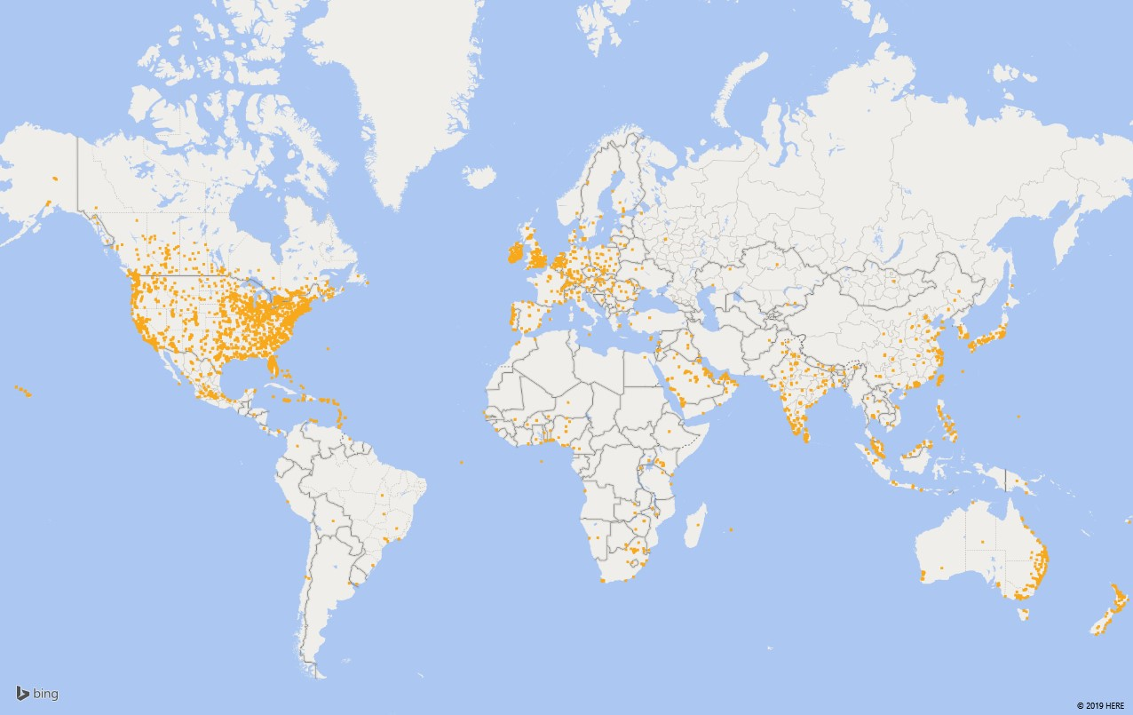
Worldwide presence
Notes:
[TOASTMASTERS AUDIENCE]
Rotary members are all over the world, just like Toastmasters. There are over 1.2 million members in 36,087 clubs in countries all over the world.

Slide 14
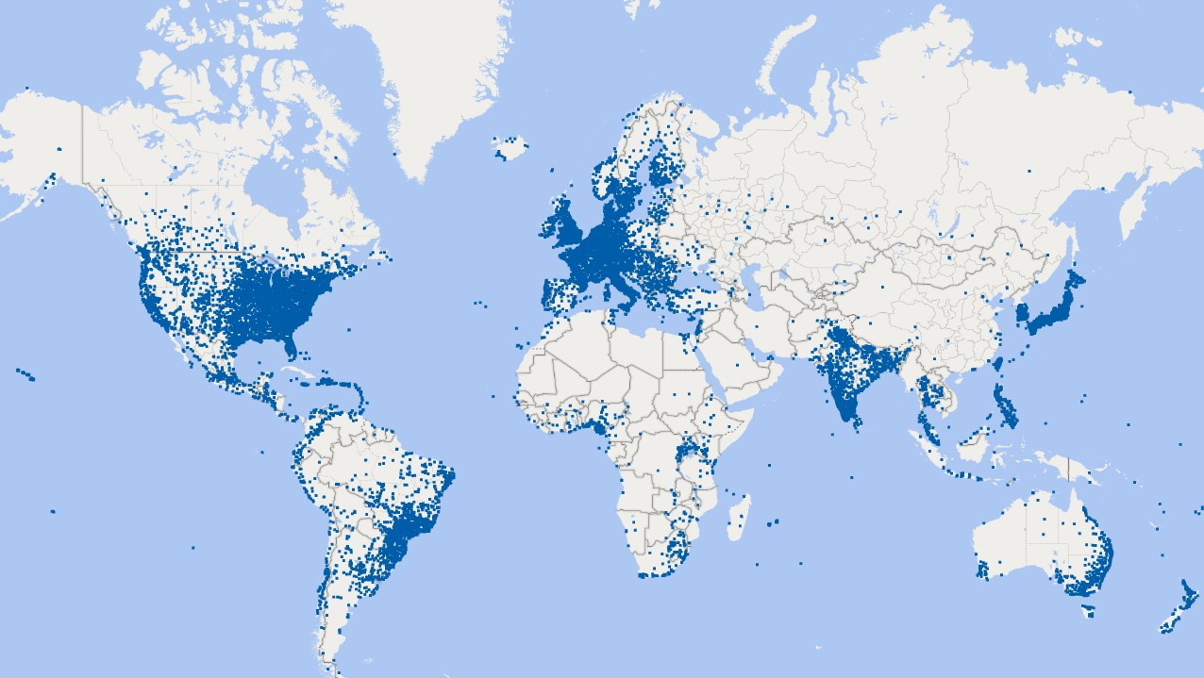
Worldwide presence
Notes:
[Toastmasters AUDIENCE]
Toastmasters clubs are in many of the same places. There are about 360,000 members in 16,700 Toastmasters clubs spread across 143 countries.

Slide 15
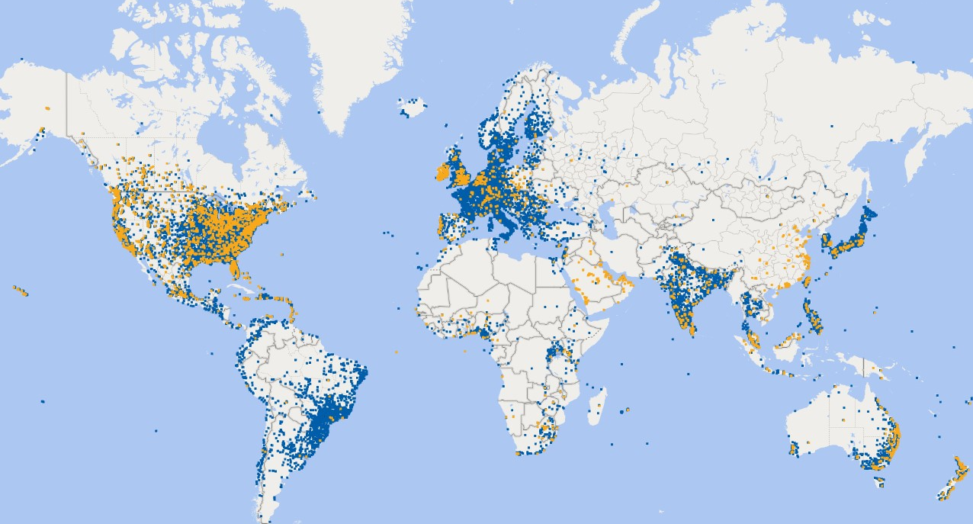
Worldwide presence
Notes:
[Toastmasters AUDIENCE]
The similarities between our organizations and worldwide presence are what led to the development of our alliance.

Slide 16
Learn More About Toastmasters
Notes:
[ROTARY AUDIENCE]
Now, let’s learn more about Toastmasters.
[TOASTMASTERS AUDIENCE]
Now, let’s learn more about Rotary.

Slide 17
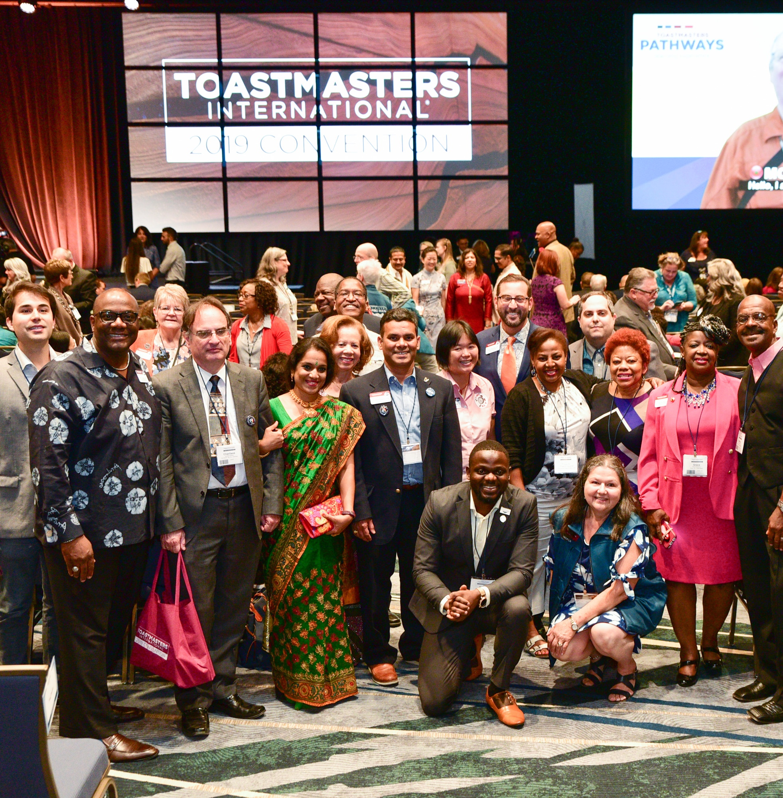
What is Toastmasters?
Educational organization
of clubs
Provides leadership and communication curriculum
Notes:
[ROTARY AUDIENCE]
Like Rotary, Toastmasters is worldwide network of clubs. As an educational non-profit organization, Toastmasters is dedicated to helping its members become more effective speakers, communicators, and leaders.

Slide 18
Who are Toastmasters members?
(Average 46.2 years)
Notes:
[ROTARY AUDIENCE]
Toastmasters International has been around since 1924, and it has helped millions of men and women through the years. There are 358,000 members in more than 16,800 clubs in 143 countries around the world.
Toastmasters is for adults at any stage of their life or career who want to develop and practice public speaking, expand their leadership skills, and share their experiences and stories with others. Most members are between 25 and 65 years old.
They trend slightly more female. 72% have a Bachelor’s or Master’s degree. 67.8% are Employed; 14.6 are self-employed; 7.8% are retired, and 9.8% are not working.

Slide 19
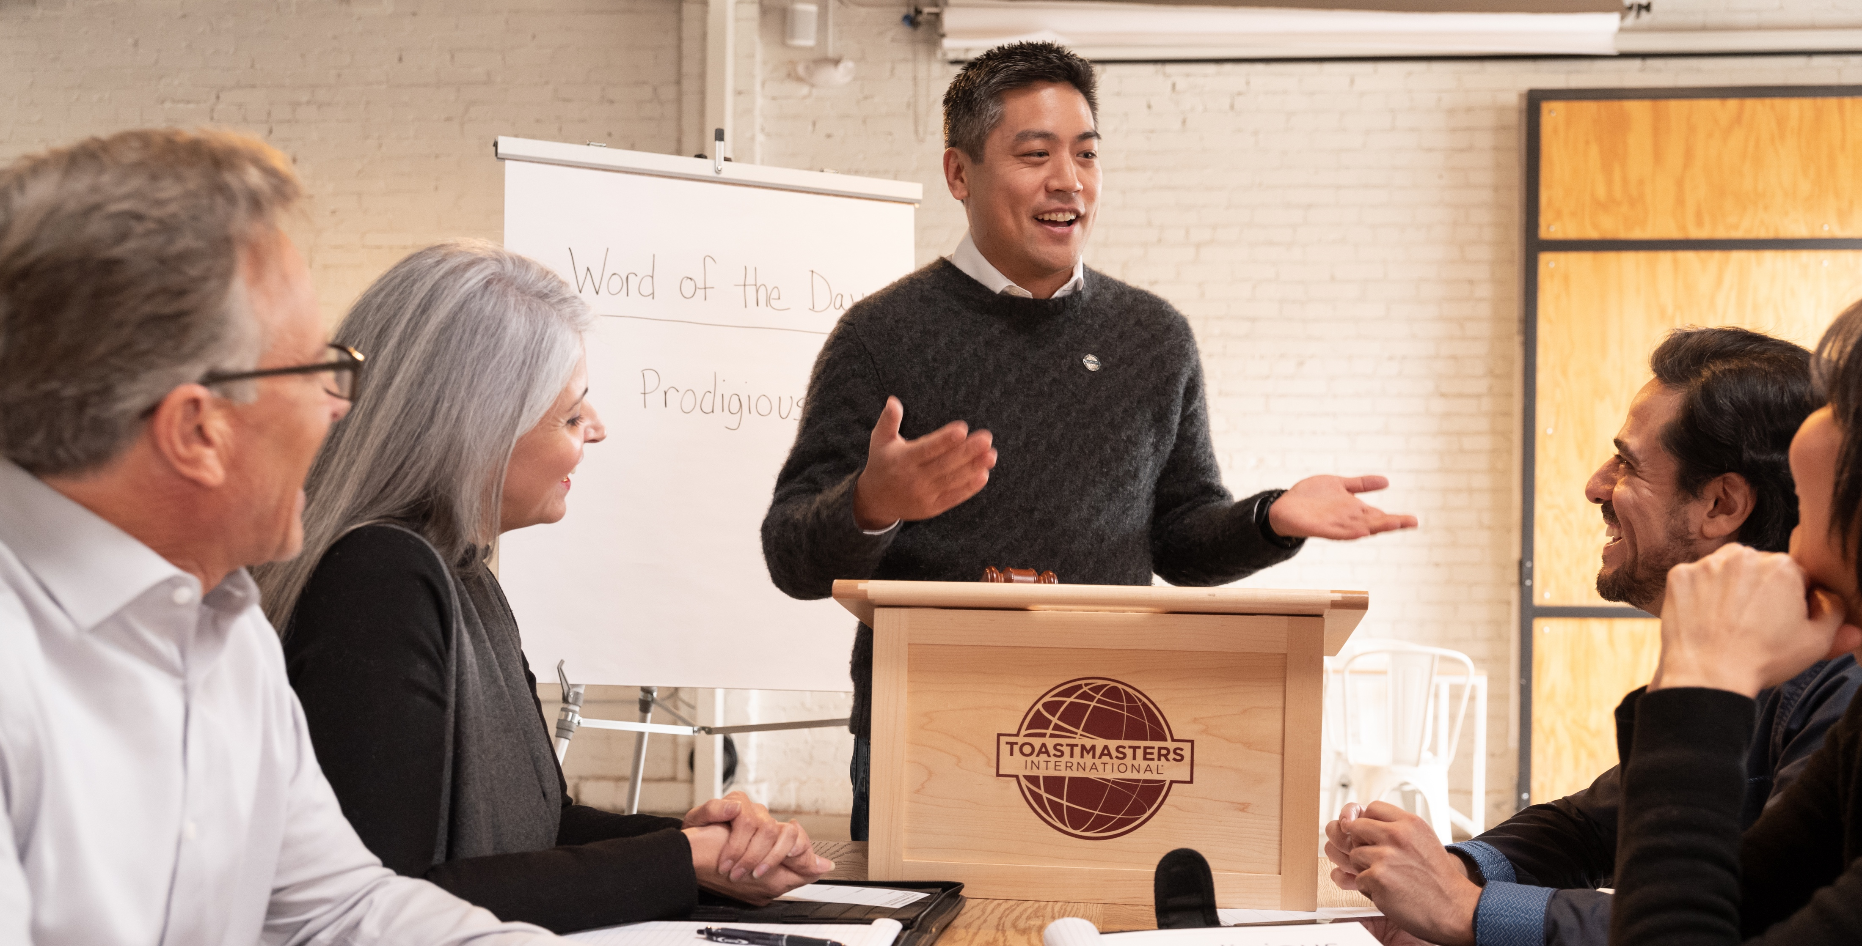
Club meetings
Notes:
[ROTARY AUDIENCE]
While Rotary members join together to solve problems in their communities, Toastmasters members meet regularly to practice their speaking and leadership skills. In addition to giving speeches, members serve in meeting roles and leadership positions to learn and practice different skills. Meetings are usually one to one and a half hours long, and are educational, enjoyable, and inspiring!
Just like Rotary and Rotaract, many clubs are adapting to online meetings as needed.

Slide 20
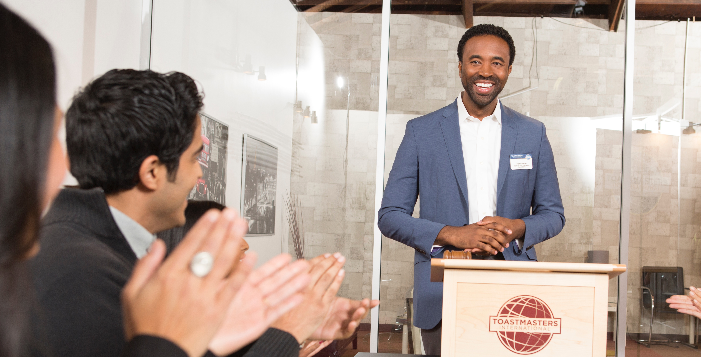
Practice
Notes:
[ROTARY AUDIENCE]
In any endeavor, practice is vital to success. Toastmasters club meetings provide a supportive environment for members to practice their speaking and leadership skills.
Their members help others learn and grow as well, so it’s just as much about helping others as it is about self-growth.

Slide 21

Feedback
Receiving and giving feedback are both valuable skills.
Notes:
[ROTARY AUDIENCE]
During club meetings, members receive constructive, practical feedback to help them grow.
Being able to give someone feedback in a way that that motivates them to do even better the next time is a skill particularly important for leaders in all aspects of life.

Slide 22
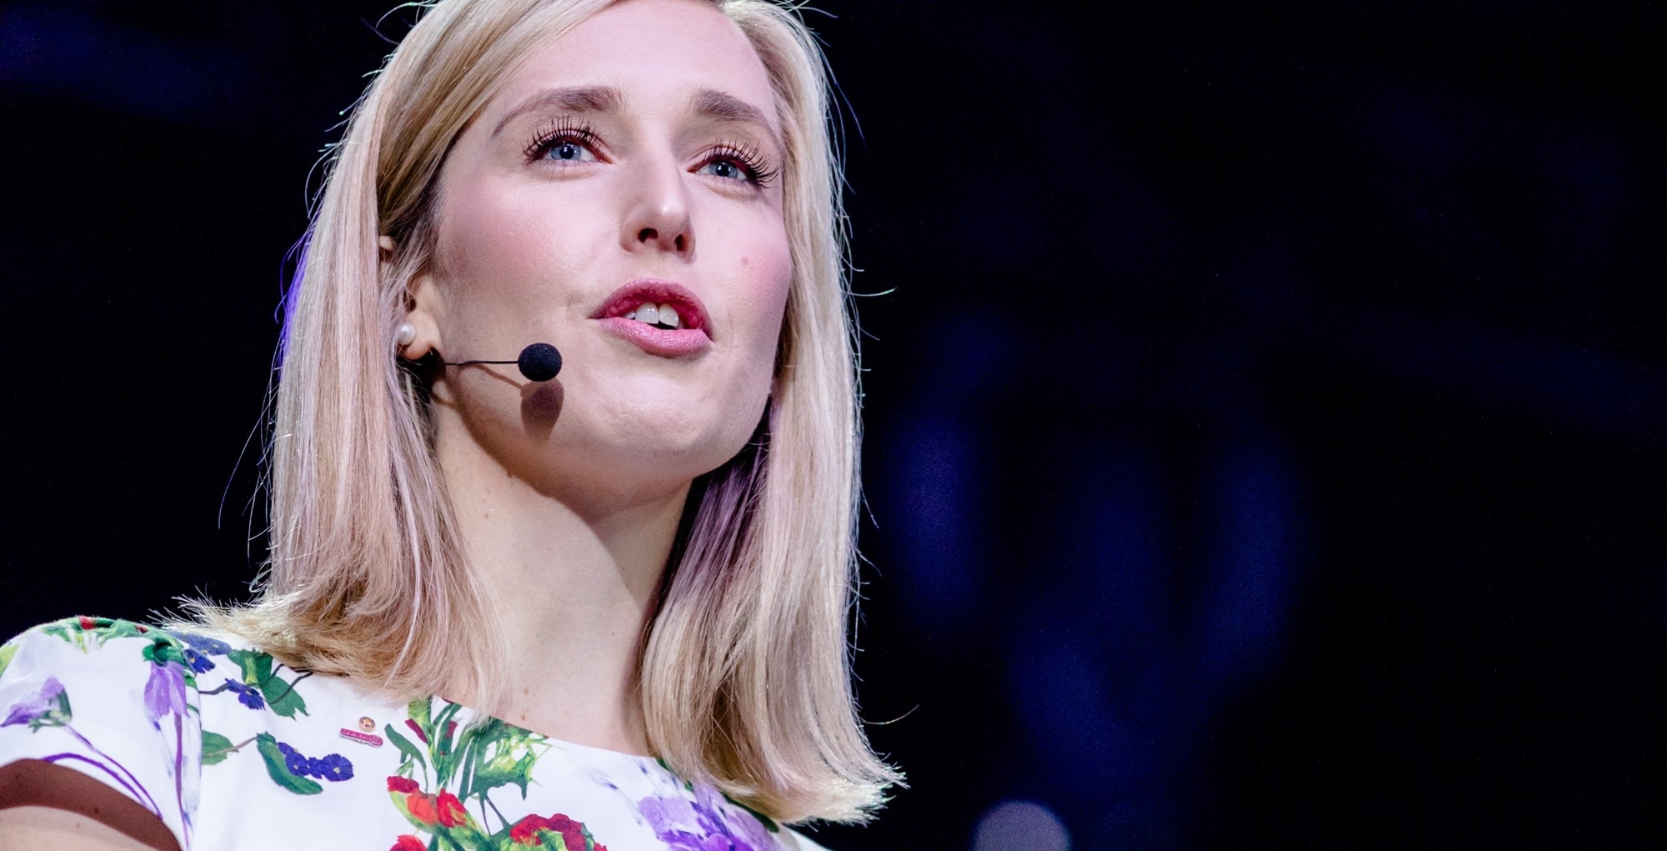
Proven results
Accomplished speakers
Confident leaders
New skillsets
Notes:
[ROTARY AUDIENCE]
The result of all this is:
•Accomplished speakers.
•Capable leaders.
•New skillsets.
•Personal and professional growth.
•The ability to effectively run meetings.
When surveyed, 93.7% of their members said that Toastmasters has helped them meet their goals and 8.8 out of 10 would recommend Toastmasters to others.

Slide 23
Organization structure
Club Leaders
Assistant Governor
District committees
District Governor
Regional Leaders
Board of Directors and
Board of Trustees
Club Leaders
Area Director
Division Director
District Director
Region Advisors
Board of Directors
Notes:
[ROTARY AUDIENCE]
As you can see our organizations are structured very similarly, from club leaders all the way up to the international president. We both value leadership and the impact one can make with strong leadership skills.

Slide 24
Worldwide presence
Notes:
[ROTARY AUDIENCE]
Toastmasters members are all over the world, just like Rotary’s. There are about 360,000 members in 16,700 Toastmasters clubs spread across 143 countries.

Slide 25
Worldwide presence – Rotary clubs
Notes:
[ROTARY AUDIENCE]
Rotary clubs are in many of the same places.

Slide 26
Worldwide presence
Notes:
[ROTARY AUDIENCE]
The similarities between our organizations and worldwide presence are what led to the development of our alliance.

Slide 27

Get Involved
Notes:
[BOTH AUDIENCES]
You may be wondering how to start getting involved with this alliance.

Slide 28

Take courses
Developed by Toastmasters International
Leadership and communication skills
Rotary’s Learning Center
Notes:
[ROTARY AUDIENCE]
Rotarians and Rotaractors can get involved by taking the online leadership and communication courses to hone and practice their skills. These courses were developed by Toastmasters International for Rotary as part of the alliance. All Rotarians and Rotaractors can access them on the Learning Center through their My Rotary accounts.

Slide 29

Toastmasters courses
Develop a Speech
Deliver a Speech
The Inspirational Speech
Interpersonal Communication
and Networking
Leadership Basics
Leading a Team
Collaboration
Building Consensus
Notes:
[ROTARY AUDIENCE]
Courses on the following topics are available in all Rotary languages. These topics address competencies that current and prospective Rotarians and Rotaractors indicated they would like to develop when surveyed.

Slide 30

Blended Learning Approach
Independent work
Assignments
Evaluation
Notes:
[ROTARY AUDIENCE]​
One of the reasons Toastmasters is so effective is their blended learning approach, which involves:​
•Independent study of concepts online​
•Experiential learning with assignments that apply the concepts learned—for example, giving a speech ​
•Peer evaluation and feedback​
​This approach is used in the courses that are available to the Rotary audience as well. ​
​
The more time and effort members devote to these courses, the more they will grow and develop these skills.

Slide 31

Reach out
Ask if you can attend your
local Toastmasters online
club meeting
Welcome a Toastmaster who visits your Rotary or Rotaract online club meeting
Invite a Toastmaster to be a guest speaker at your online
club meeting
Notes:
[ROTARY AUDIENCE]​
Besides taking the courses, you can also get involved simply by reaching out to your local Toastmasters club. For example, you can:​
​
•Visit a Toastmasters club meeting. Ask club leaders if you can attend as a guest—online or otherwise—to observe how it works. Stay afterward and introduce yourself. You could invite a member to attend your Rotary or Rotaract club meeting as well.​
•Welcome Toastmasters who may visit your club to learn more about Rotary and Rotaract.​
•Invite a Toastmasters member to be a guest speaker at an upcoming meeting.​
There are a lot of possibilities for collaboration at the grassroots level.​
​
While both Toastmasters International and Rotary International have communicated this alliance to members, some clubs/members may still be unaware. If you reach out and find that is the case, help spread the word by sharing the information you have and directing them to the website listed at the end of this presentation. ​
​
If there isn't a club near you, find one that meets online that you could attend. Rotary and Rotaract members can also get involved by learning about Toastmasters or exploring the many resources, tips, and podcasts available on public speaking, and by engaging in the leadership development program that Toastmasters International developed for Rotary and Rotaract members. These courses can help members improve their public speaking and leadership skills.

Slide 32
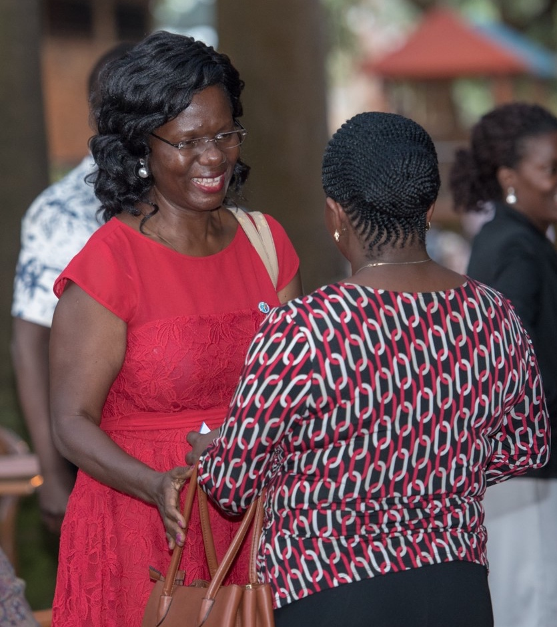
Reach out
Ask if you can attend your local Toastmasters club meeting
Welcome a Toastmaster who visits your Rotary or Rotaract club meeting
Invite a Toastmaster to be
a guest speaker at your club meeting
Notes:
[ROTARY AUDIENCE]​
Besides taking the courses, you can also get involved simply by reaching out to your local Toastmasters club. For example, you can:​
​
•Visit a Toastmasters club meeting. Ask club leaders if you can attend as a guest—online or otherwise—to observe how it works. Stay afterward and introduce yourself. You could invite a member to attend your Rotary or Rotaract club meeting as well.​
•Welcome Toastmasters who may visit your club to learn more about Rotary and Rotaract.​
•Invite a Toastmasters member to be a guest speaker at an upcoming meeting.​
There are a lot of possibilities for collaboration at the grassroots level.​
​
While both Toastmasters International and Rotary International have communicated this alliance to members, some clubs/members may still be unaware. If you reach out and find that is the case, help spread the word by sharing the information you have and directing them to the website listed at the end of this presentation. ​
​
If there isn't a club near you, find one that meets online that you could attend. Rotary and Rotaract members can also get involved by learning about Toastmasters or exploring the many resources, tips, and podcasts available on public speaking, and by engaging in the leadership development program that Toastmasters International developed for Rotary and Rotaract members. These courses can help members improve their public speaking and leadership skills.

Slide 33
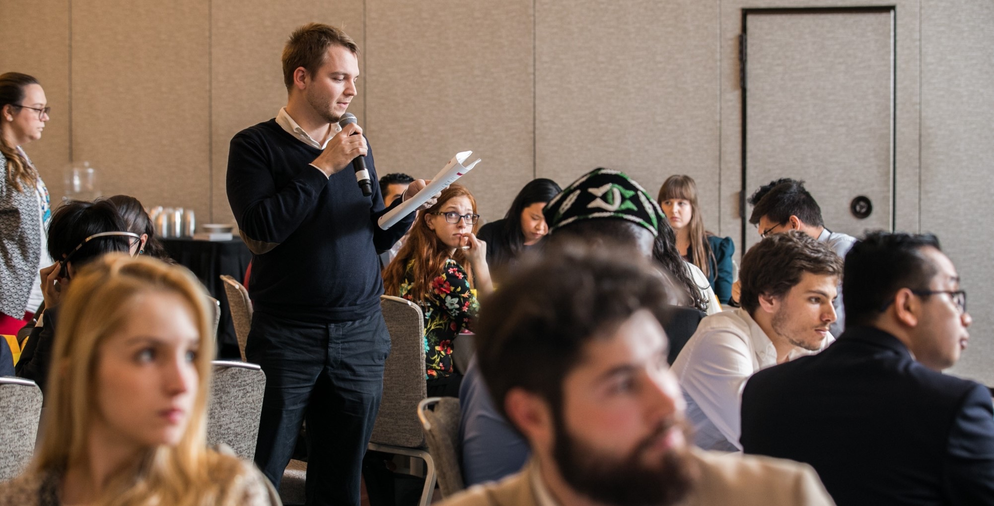
Cross-Training Opportunities
Notes:
[ROTARY AUDIENCE]
Many clubs around the world are already teaming up with their local Toastmasters clubs in various ways.
Some have invited each other to their district training events to be speakers or trainers. For example, one Rotary Institute organizer invited a Toastmasters member to lead a public speaking workshop for DGs, DGEs, and DGNs. The Rotarians were happy with the session and the Toastmasters member was pleased to share his skills to help others.

Slide 34

Collaboration
Leadership development programs
Cross-mentor pairs
Social or networking events
Notes:
[ROTARY AUDIENCE]
Some club and district leaders are getting together with their local Toastmasters club and district leaders to discuss ways they could work together to benefit their members, including
Starting a leadership development program in their clubs, leveraging the courses developed by Toastmasters International and supporting members who want to participate
Offering a cross mentor program where Toastmasters can pair up with Rotarians and Rotaractors to share expertise
Holding a social or networking event so that members of both clubs or districts can connect and expand their networks
NOTE: Rotary and Toastmasters clubs are a lot alike: each club is autonomous and determines its own activities and priorities to reflect their members’ interests and the community’s needs. If Toastmasters club doesn’t have the capacity or interest in working together, there may be another club nearby that would be a better fit.

Slide 35
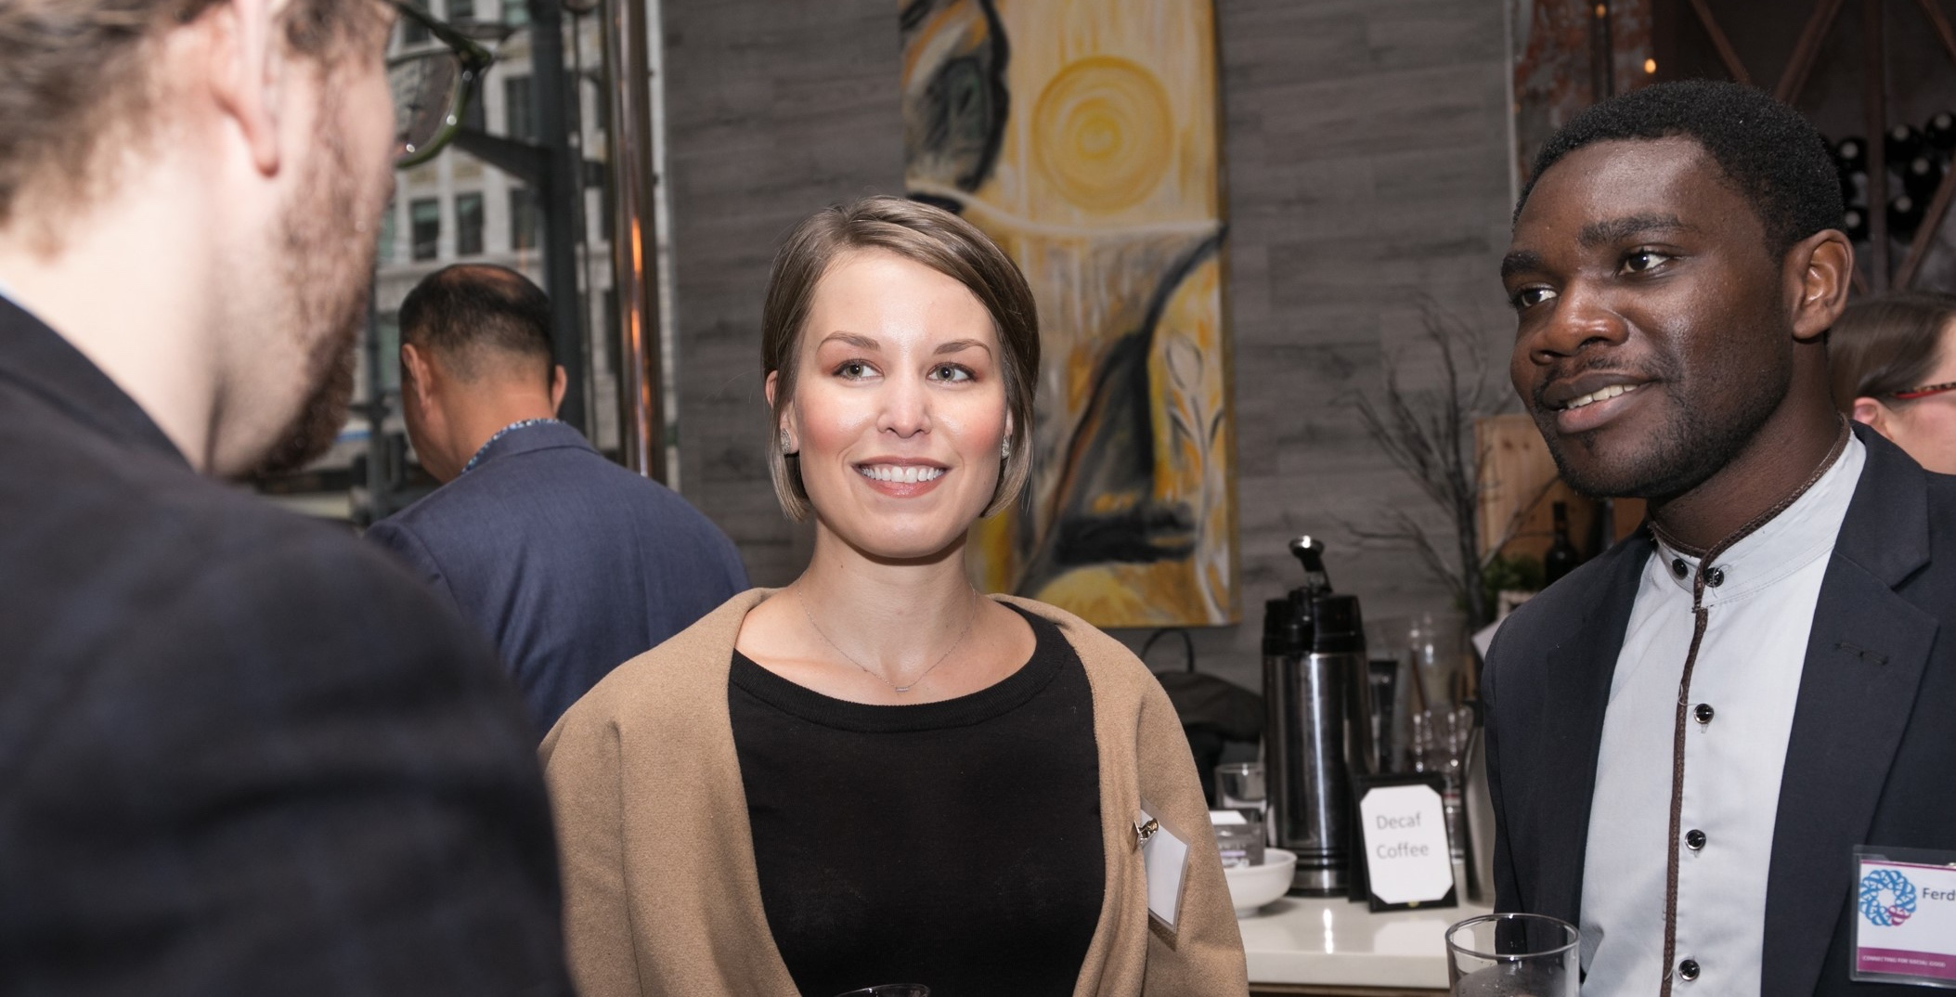
Dual Members
Notes:
[ROTARY AUDIENCE]
There are many Rotary members who are also active Toastmasters members. If you have members in your club who also belong to Toastmasters, leverage their expertise and experience. They can share observations about your club meetings or speakers and share feedback, such as offering tips for introducing speakers. Or, if you want feedback on a speech, you could ask if you can deliver it at one of their meetings and receive feedback. Our alliance makes it possible to benefit from the expertise of each other's organizations without joining.

Slide 36
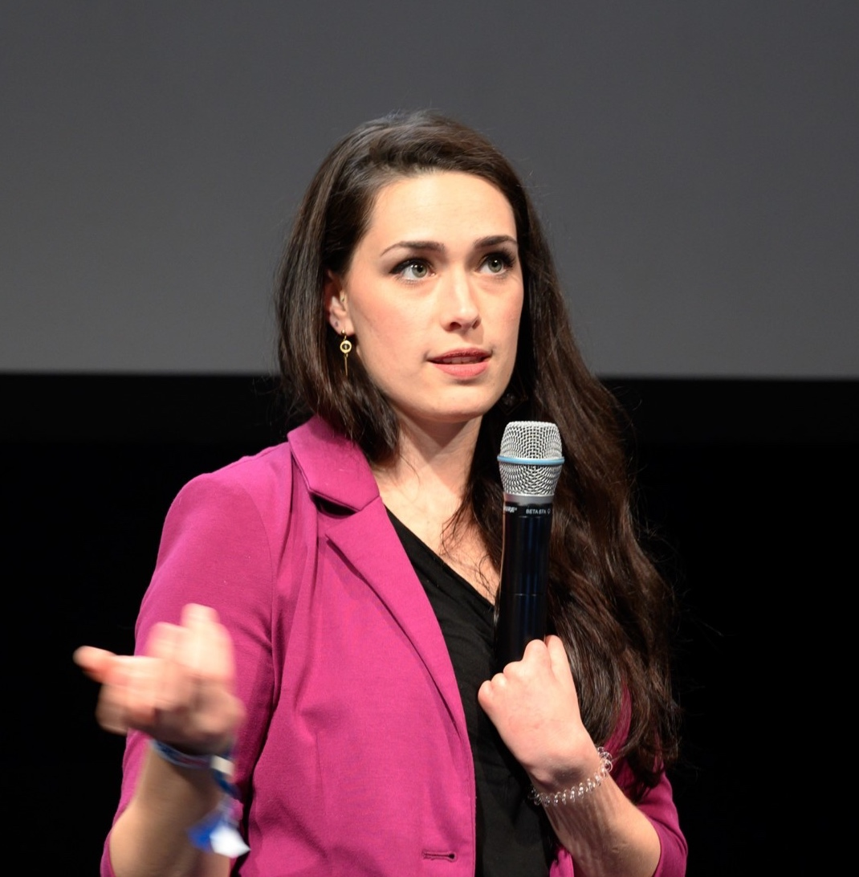
Source your speakers
If you are looking for speakers for meetings or events, consider your local Toastmasters club.
Notes:
[ROTARY AUDIENCE]
You can also:
Expand your networks and source Toastmasters for your training or speaking events. Toastmasters members welcome opportunities to speak in new environments.
Offer to be a speaker at a Toastmasters district conference or training event to share your Rotary story.

Slide 37
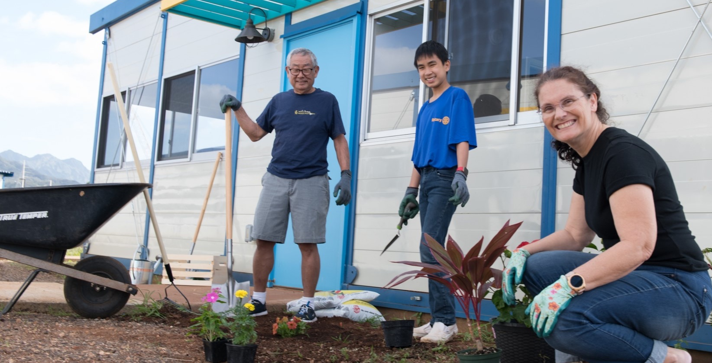
Invite Toastmasters to Service Projects
Notes:
[ROTARY AUDIENCE]
Finally, If you need more volunteers for a service project, inviting Toastmasters to participate is a great way to share the personal growth that comes from doing good in the world. the more people who can help give back to our communities the better! What better way for Toastmasters members to see what Rotary does first-hand. Combining our expertise can increase our collective impact in the world.

Slide 38
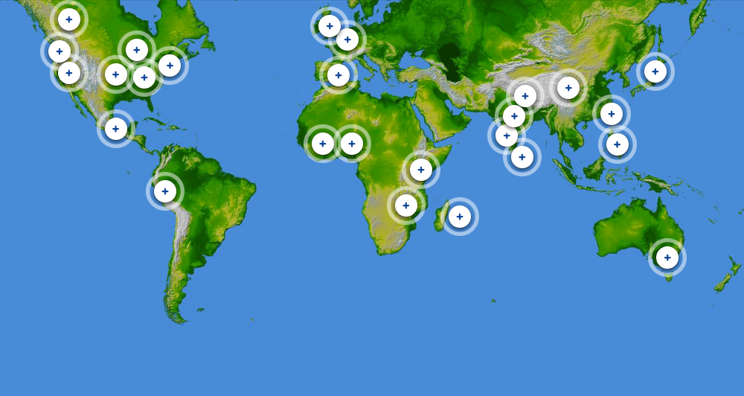
Notes:
[ROTARY AUDIENCE]
Members all around the world are collaborating with Toastmasters and letting us know about it.
[https://rise.articulate.com/share/JVvJYubPX7EitzMtlGpgvzFB18pmZviv]

Slide 39
Rotary courses
Developed by Toastmasters International
Leadership and communication skills
Rotary’s Learning Center
Notes:
[TOASTMASTERS AUDIENCE]​
Rotarians are receiving online leadership and communication courses developed by Toastmasters for Rotary as part of the alliance. The courses developed for Rotary are based on the Toastmasters’ Pathways curriculum, but they are not the same. These courses are specifically for Rotary and take content from various Pathways projects already available to Toastmasters.

Slide 40
Course Topics
Develop a Speech
Deliver a Speech
The Inspirational Speech
Interpersonal Communication
Leadership Basics
Leading a Team
Collaboration
Inclusive Leadership
Notes:
[TOASTMASTERS AUDIENCE]
The courses that were developed for Rotary include the following topics. As you can see, these are similar to a few of the projects that exist in Pathways.

Slide 41
Reach out
Ask if you can attend your
local Rotary online club meeting
Welcome a Rotarian who
visits your Toastmasters online club meeting
Invite a Rotarian to be a
guest speaker at your online
club meeting
Notes:
[TOASTMASTER AUDIENCE]​
You can reach out to your local counterpart club. For example, you can:​
•Visit a Rotary club meeting. Ask club leaders if you can attend as a guest–online or otherwise—to observe how it works. Stay afterward and introduce yourself. You could invite a member to attend your club meeting as well. ​
•Welcome Rotarians who may visit your club to learn more about Toastmasters. ​
•Invite a Rotarian to be a guest speaker at an upcoming meeting. ​
There are a lot of possibilities for collaboration at the grassroots level.​
While both Toastmasters International and Rotary International have communicated this alliance to members, some clubs/members may still be unaware. If you reach out and find that is the case, help spread the word by sharing the information you have and directing them to the website listed at the end of this presentation. ​
​If there isn't a club near you, Toastmasters members can still get involved by learning about Rotary, connecting to an online community, or creating My Rotary account to access online courses on topics Rotary has expertise in.​

Slide 42
Reach out
Ask if you can attend your local Rotary club meeting
Welcome a Rotarian who visits your Toastmasters club meeting
Invite a Rotarian to be a guest speaker at your club meeting
Notes:
[TOASTMASTER AUDIENCE]​
You can reach out to your local counterpart club. For example, you can:​
•Visit a Rotary club meeting. Ask club leaders if you can attend as a guest–online or otherwise—to observe how it works. Stay afterward and introduce yourself. You could invite a member to attend your club meeting as well. ​
•Welcome Rotarians who may visit your club to learn more about Toastmasters. ​
•Invite a Rotarian to be a guest speaker at an upcoming meeting. ​
There are a lot of possibilities for collaboration at the grassroots level.​
While both Toastmasters International and Rotary International have communicated this alliance to members, some clubs/members may still be unaware. If you reach out and find that is the case, help spread the word by sharing the information you have and directing them to the website listed at the end of this presentation. ​
​If there isn't a club near you, Toastmasters members can still get involved by learning about Rotary, connecting to an online community, or creating My Rotary account to access online courses on topics Rotary has expertise in.​

Slide 43
Cross-Training Opportunities
Notes:
[TOASTMASTERS AUDIENCE]
Many clubs and Districts around the world are already teaming up with their local Rotary or Rotaract clubs in various ways.
Some have invited each other to their district training events to be speakers or trainers. For example, one Rotary training event organizer invited a Toastmasters member to lead a public speaking workshop for their incoming district leaders.

Slide 44
Collaboration
Leadership development programs
Cross-mentor pairs
Social or networking events
Notes:
[TOASTMASTERS AUDIENCE]
Some club and district leaders are getting together with their local Rotary or Rotaract club and district leaders to discuss ways they could work together to benefit their members, including
Toastmasters members hosting Rotary and Rotaract members who are working on their public speaking skills and providing expert evaluations
Developing a cross mentor program where Toastmasters can pair up with Rotarians and Rotaractors to share expertise
Holding a social or networking event so that members of both clubs or districts can connect ad expand their networks
NOTE: Rotary and Toastmasters clubs are a lot alike: each club is autonomous and determines its own activities and priorities to reflect their members’ interests and the community’s needs. If a Rotary or Rotaract club doesn’t have the capacity or interest in working together, there may be another club nearby that would be a better fit.

Slide 45
Dual Members
Notes:
[TOASTMASTERS AUDIENCE]
There are many Toastmasters members who are also active Rotary or Rotaract members. If you have members in your club who also belong to Rotary, leverage their expertise and experience. They have amazing stories to tell about projects they have worked on. There are also topics that club leaders on both sides can relate to such as attracting and engaging members, new member orientation, and preparing your successor. Our alliance makes it possible to benefit from the expertise of each other's organizations without joining.

Slide 46
Source your speakers
If you are looking for speakers for meetings or events, consider your local Rotary or Rotaract club.
Notes:
[TOASTMASTERS AUDIENCE]
When your club needs a guest speaker for an event or a test speaker for a contest, invite a local Rotarian. Rotary members welcome opportunities to share their Rotary stories.
Offer to be a speaker at a Rotary district conference or training event to share your expertise. Be sure to ask the organizer what they would like you to speak about.

Slide 47
Participate in
Service Projects
Notes:
[TOASTMASTERS AUDIENCE]
Finally, you could put your leadership and public speaking skills to use toward a good cause by getting involved in Rotary service projects. Talk to your local Rotary club leaders to see how you might be able to get involved and whether there is a Rotary Community Corps in your area.

Slide 48
Notes:
[ROTARY AUDIENCE]
Members all around the world are collaborating with Toastmasters and letting us know about it.
[https://rise.articulate.com/share/JVvJYubPX7EitzMtlGpgvzFB18pmZviv]

Slide 49
The Alliance
Learn More
Get Involved

Slide 50
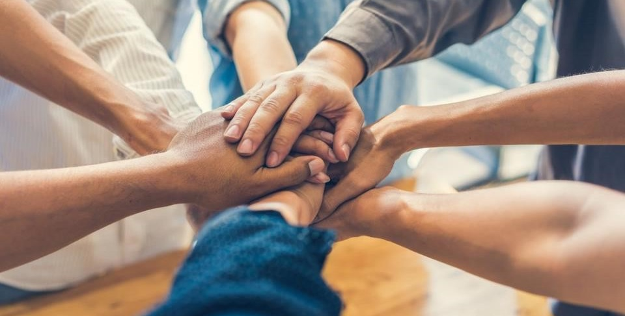
www.toastmasters.org/Rotary
Notes:
[ROTARY AUDIENCE]
Learn more by visiting rotary.org/toastmasters. There you can find:
•An overview of the alliance
•Ways to get involved
•Links to Toastmasters-developed courses on communication and leadership skills
•Links to stories of grassroots interactions
•FAQs and other resources

Slide 51
Questions?
Email: ToastmastersAlliance@rotary.org
Notes:
[ROTARY AUDIENCE]
What questions do you have?
You can send any questions about the alliance to ToastmastersAlliance@rotary.org.

Slide 52
TOASTMASTERS.ORG/ROTARY
Notes:
[TOASTMASTERS AUDIENCE]
Learn more by visiting toastmasters.org/rotary. There you can find:
•An overview of the alliance
•FAQs and other resources

Slide 53
Questions?
Email: RotaryAlliance@toastmasters.org
Notes:
[TOASTMASTERS ALLIANCE]
What questions do you have?
You can send any questions about the alliance to RotaryAlliance@toastmasters.org.

